Slide 1
TS2Vec: Towards Universal Representation of Time Series
AAAI 2022
報告人: 汪文豪

Slide 2
Content
Previous work
Method
Problem Definition
Model Architecture
Hierarchical Contrasting
Time Series Anomaly Detection
Conclusion

Slide 3
Previous work

Slide 4
The related work in the past
Focused on learning instance-level representations
In clustering and classification tasks, there is a great performance.
Tonekaboni, Eytan, and Goldenberg 2021; Franceschi, Dieuleveut, and Jaggi 2019; Wu et al. 2018
Employed the contrastive loss to learn the inherent structure of time series.
Eldele et al. 2021; Franceschi, Dieuleveut, and Jaggi 2019
Notes:
instance-level representations => the whole segment of the input time series
時間序列的內在結構指的是時間序列數據中存在的規律性或潛在的結構。時間序列是按照時間順序排列的數據集合，通常用於分析過去、現在和未來的趨勢和模式。時間序列的內在結構可能包括重複出現的週期性模式、趨勢和季節性變化等。通過學習時間序列的內在結構，我們可以更好地理解和預測時間序列的行為。
=> Inherent structure

Slide 5
Limitations in existing methods
Instance-level representations may not be suitable for tasks that need fine-grained representations.
Few of the existing methods distinguish the multiscale contextual information with different granularities.
TNC, T-Loss
Multiscale features may provide different levels of semantics and improve the generalization capability of learned representations
Notes:
Forecasting 和 anomaly detection 是需要對時間序列數據進行分析和預測的任務。在這些任務中，數據的細節特徵對於結果的影響非常重要，而 coarse grained representation 通常無法捕捉數據的細節特徵，只能考慮數據的高層次特徵，例如趨勢和季節性等，因此在進行時間序列預測和異常檢測時，使用 coarse grained representation 可能會導致預測和檢測的精度降低。相反，使用 fine-grained representation 能夠更好地捕捉數據中的細節特徵，進而提高預測和檢測的精度。因此，在進行時間序列預測和異常檢測時，通常需要使用 fine-grained representation。
TNC => discriminates among segments with a constant length 常數長度內去辨別segment
T-Loss => 從原始時間序列中抽取隨機子序列當作正樣本
Multiscale features may provide different levels of semantics and improve the generalization capability of learned representations

Slide 6
Limitations in existing methods (Cont.)
Most existing methods of unsupervised time series representation are inspired by experiences in CV and NLP domains
Transformation-invariance & Cropping invariance
In time series are not always applicable.
The distributions and semantics of time series may change over time.
Notes:
Transformation-invariance & Cropping invatiance，對比學習中常用的手法，以CV來說是就是將照片反轉，亦或是將照片做放大縮小
transformation-invariance通常指的是對於圖像等視覺數據進行旋轉、縮放、平移等操作後，模型輸出的結果不會受到這些變換的影響。例如，對於一個人臉識別模型，旋轉、縮放、平移等操作都不應該影響其識別準確率，因為人臉的特徵是不會因為這些變換而發生改變的。
cropping-invariance通常指的是對於圖像等視覺數據進行裁剪操作後，模型輸出的結果不會受到裁剪位置和大小的影響。例如，在圖像分類任務中，對於一個狗的圖像，不論是對整個圖像進行分類還是只對其中一部分進行分類，模型的輸出結果都應該是狗。
在NLP領域中，transformation-invariance和cropping-invariance的概念也可以類比到文本數據中。例如，在文本分類任務中，對於同一段文本進行一定的變換或裁剪後，模型的輸出結果應該是相同的，具有一定的不變性。

Slide 7
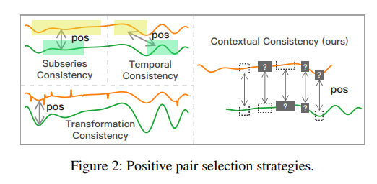
Contextual Consistency – previous work
In contrative learning, the positive pairs selection is important.
In the previous works, the strategies are summarized as follows:
Subseries consistency
Encourages the representation of a time series to be closer its sampled subseries
Temporal consistency
Enforces the local smoothness of representations by choosing adjacent segments as positive samples
Transformation consistency
Augments input series by different transformations, such as scaling, permutation, etc., encouraging the model to learn transformation-invariant representations

Slide 8
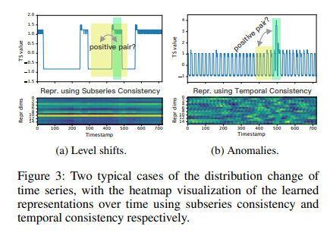
Contextual Consistency – previous work
The green and yellow parts have different patterns.
To overcome this problem, context is generated by applying timestamp masking and random cropping on the input time series.

Slide 9
TS2Vec
Enables the representation learning of time series in all semantic levels
It hierarchically discriminates positive and negative samples at instance-wise and temporal dimensions
For an arbitrary sub-series, its overall representation can obtained by a max pooling over the corresponding timestamps.
Notes:
使model可以抓到上下文資訊在時間維度的多種分辨率上並且產生任何粒度上細粒度的表徵

Slide 10
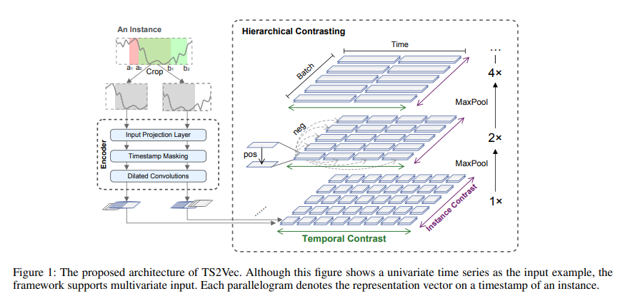
TS2Vec (Cont.)
The contrasting objective
Base on augmented context views
Same sub-series in two augmented contexts should be consistent.

Slide 11
Method

Slide 12
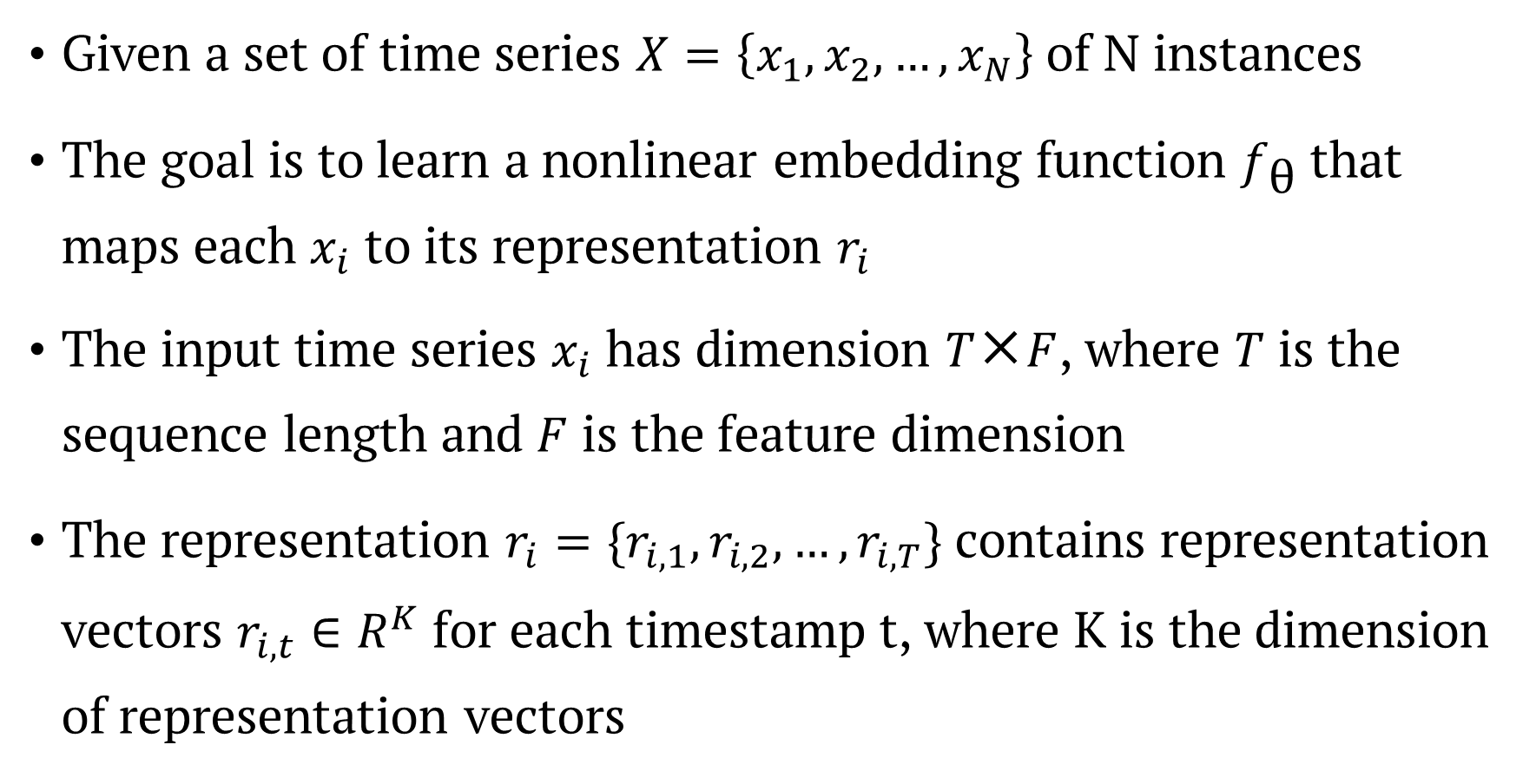
Problem Definition
Given a set of time series $X=\left\{x_{1}, x_{2},…, x_{N}\right\}$ of N instances
The goal is to learn a nonlinear embedding function $f_{\text{θ}}$ that maps each $x_{i}$ to its representation $r_{i}$
The input time series $x_{i}$ has dimension $T\text{×}F$, where $T$ is the sequence length and $F$ is the feature dimension
The representation $r_{i}=\{r_{i, 1}, r_{i,2},…,r_{i, T}\}$ contains representation vectors $r_{i,t}∈R^{K}$ for each timestamp t, where K is the dimension of representation vectors

Slide 13



The goal
T
T
$$f_{\text{θ}}$$
F
K
$x_{i}$
$r_{i}$
Notes:
Given a set of time series $X=\left\{x_{1}, x_{2},…, x_{N}\right\}$ of N instances
The goal is to learn a nonlinear embedding function $f_{\text{θ}}$ that maps each $x_{i}$ to its representation $r_{i}$
The input time series $x_{i}$ has dimension $T\text{×}F$, where $T$ is the sequence length and $F$ is the feature dimension
The representation $r_{i}=\{r_{i, 1}, r_{i,2},…,r_{i, T}\}$ contains representation vectors $r_{i,t}∈R^{K}$ for each timestamp t, where K is the dimension of representation vectors

Slide 14
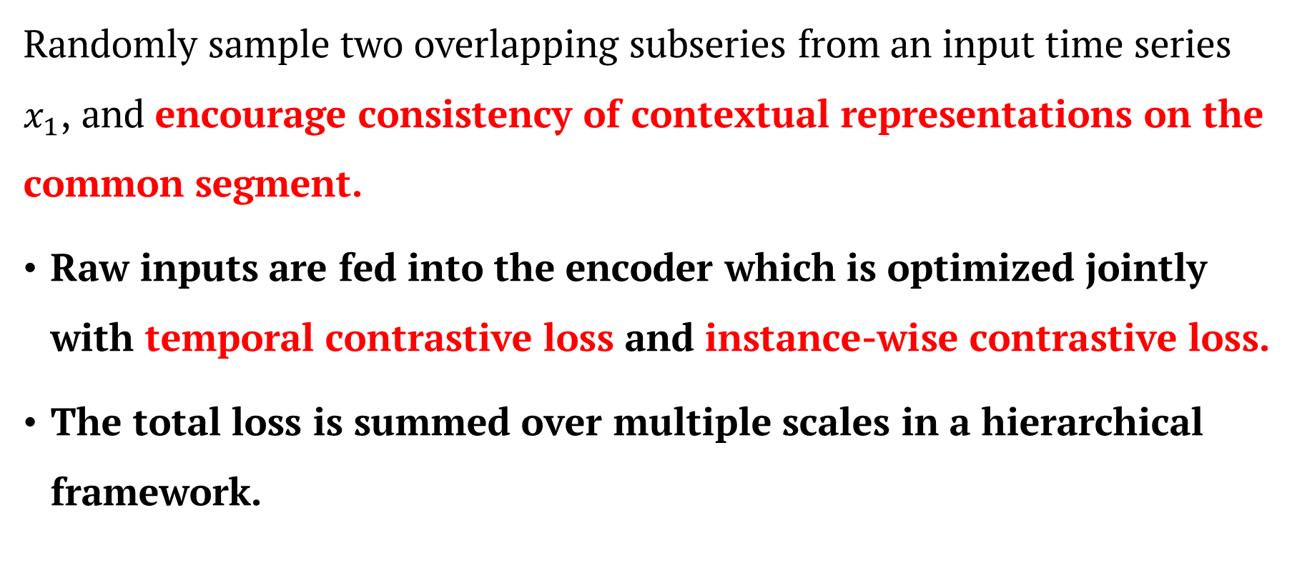
Model Architecture – Positive pair selection
Randomly sample two overlapping subseries from an input time series $x_{1}$, and encourage consistency of contextual representations on the common segment.
Raw inputs are fed into the encoder which is optimized jointly with temporal contrastive loss and instance-wise contrastive loss.
The total loss is summed over multiple scales in a hierarchical framework.
Notes:
1. 正樣本

Slide 15
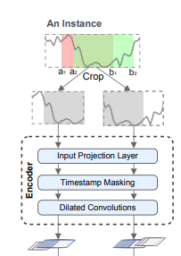
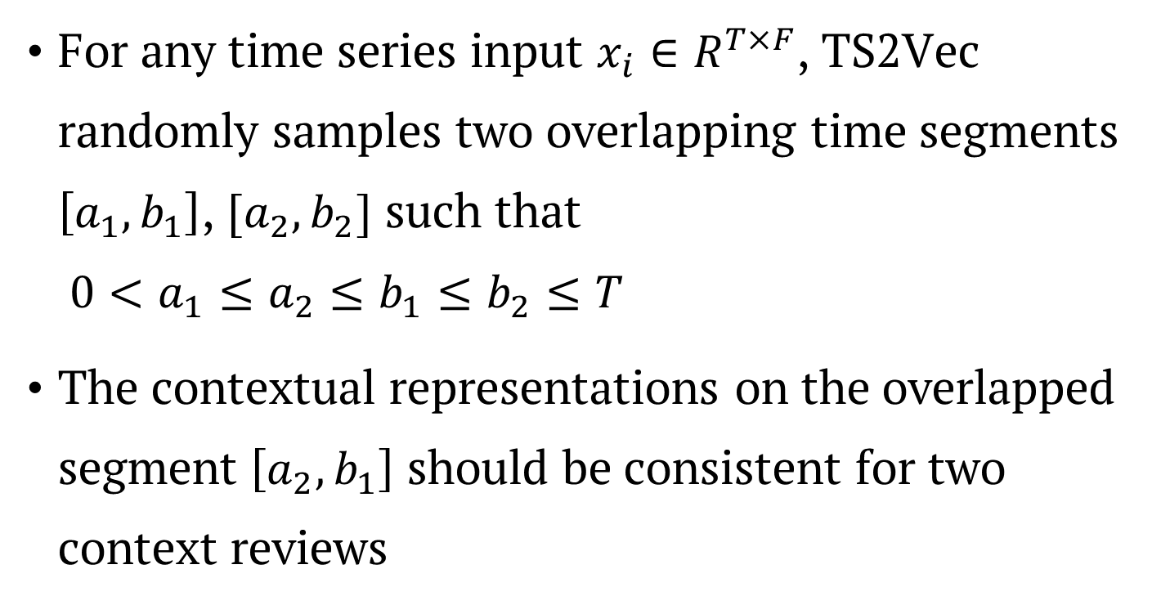
Random Cropping
For any time series input $x_{i}∈R^{T×F}$, TS2Vec randomly samples two overlapping time segments $\left[a_{1},b_{1}\right]$, $[a_{2}, b_{2}]$ such that $0<a_{1}≤a_{2}≤b_{1}≤b_{2}≤T$
The contextual representations on the overlapped segment $\left[a_{2}, b_{1}\right]$ should be consistent for two context reviews

Slide 16
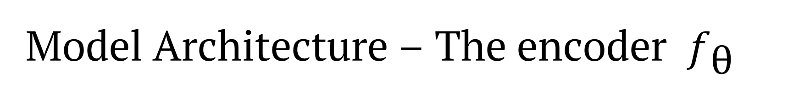
Model Architecture – The encoder $f_{\text{θ}}$
Three components
Input projection layer
Timestamp masking module
Dilated CNN module

Slide 17




Input projection layer
For each input $x_{i}$, the input projection layer is a fully connected layer that maps the observation $x_{i,t}$ at timestamp $t$ to a high-dimensional latent vectors $z_{i,t}$
Fully Connected Layer
$$F^{′}>F$$
$$F$$
$x_{i}$
$z_{i}$

Slide 18
Model Architecture – The encoder $f_{\text{θ}}$
Three components
Input projection layer
Timestamp masking module
Dilated CNN module

Slide 19







Timestamp masking module
Masks the latent vactor $z_{i}=\{z_{i, t}\}$ after the Input Projection Layer along the time axis with a binary mask $m∈{\left\{0, 1\right\}}^{T}$
Bernoulli distribution with $p=0.5$
$F^{′}$
$F^{′}$
mask: {1 1 1 1 0 1 1 0}
Masking
$T$
$T$
$z_{i}$
$z_{i}$

Slide 20
Model Architecture – The encoder $f_{\text{θ}}$
Three components
Input projection layer
Timestamp masking module
Dilated CNN module

Slide 21
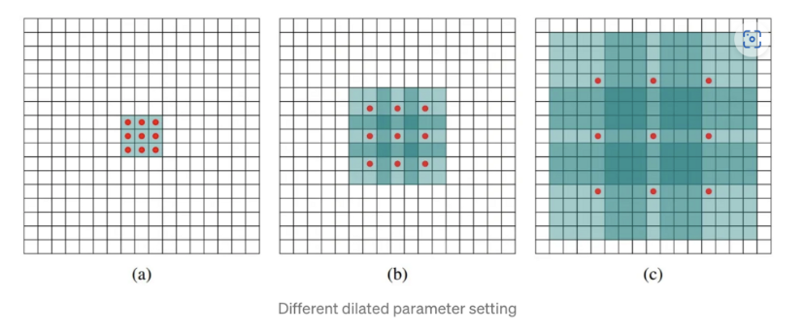
Dilated CNN module introduction
Notes:
dilated的好處是不做pooling損失信息的情況下，加大了感受野，讓每個卷積輸出都包含較大範圍的信息。
在圖像需要全局信息或者語音文本需要較長的sequence信息依賴的問題中，都能很好的應用dilated conv，比如圖像分割、語音合成WaveNet、機器翻譯ByteNet中。

Slide 22
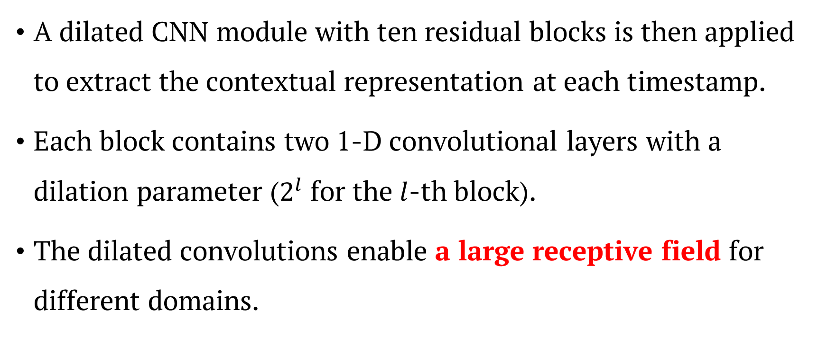
Dilated CNN module
A dilated CNN module with ten residual blocks is then applied to extract the contextual representation at each timestamp.
Each block contains two 1-D convolutional layers with a dilation parameter ($2^{l}$ for the $l$-th block).
The dilated convolutions enable a large receptive field for different domains.

Slide 23




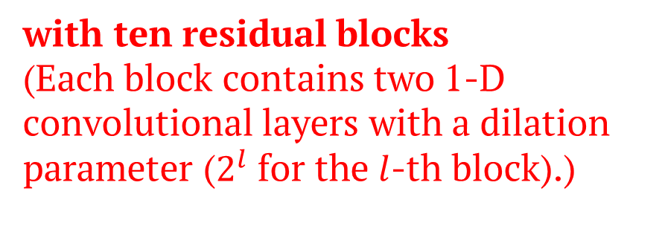


DilatedCovEncoder
$F^{′}$
$F^{′}$
Dilated CNN
with ten residual blocks (Each block contains two 1-D convolutional layers with a dilation parameter ($2^{l}$ for the $l$-th block).)
$T$
$T$
$z_{i}$
$r_{i}$

Slide 24





Each cov block’s processing..
* Kernel size: 1x3, Dilation: 1, receptive_field = (kernel size – 1) * dilation + 1, padding = receptive_field // 2
$F^{′}$
2 convolution’s with gelu
+
$T$
$z_{i}$
$z_{i}^{′}$
$z_{i}^{′′}$

Slide 25
Each cov block’s processing..
* Kernel size: 1x3, Dilation: 1, receptive_field = (kernel size – 1) * dilation + 1, padding = receptive_field // 2
$F^{′}$
2 convolution’s with gelu
+
$T$
$z_{i}$
$z_{i}^{′}$
$z_{i}^{′′}$

Slide 26
Each cov block’s processing..
* Kernel size: 1x3, Dilation: 2, receptive_field = (kernel size – 1) * dilation + 1, padding = receptive_field // 2
$F^{′}$
2 convolution’s with gelu
+
$T$
$z_{i}$
$z_{i}^{′}$
$z_{i}^{′′}$

Slide 27
Each cov block’s processing..
* Kernel size: 1x3, Dilation: 2, receptive_field = (kernel size – 1) * dilation + 1, padding = receptive_field // 2
$F^{′}$
2 convolution’s with gelu
+
$T$
$z_{i}$
$z_{i}^{′}$
$z_{i}^{′′}$

Slide 28
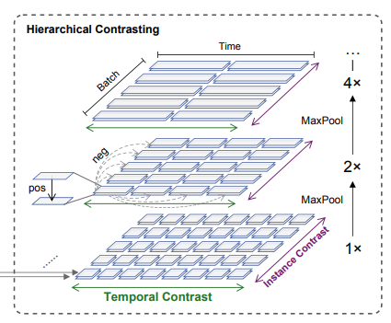
Hierarchical Contrasting (Loss function)
Forces the encoder to learn representations at various scales
Apply max pooling on the learned representations along the time axis

Slide 29
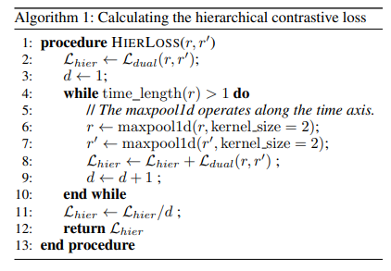
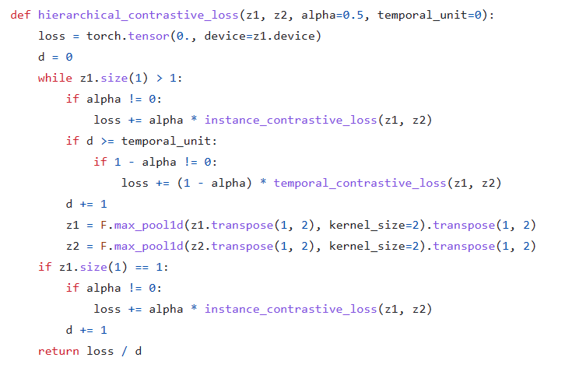
alpha = weight of instance and temporal

Slide 30
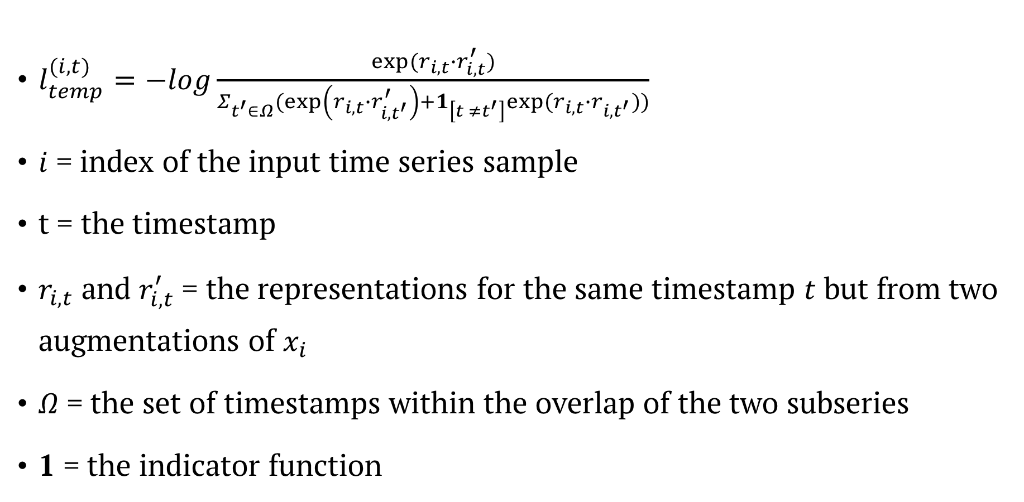
Temporal Contrastive Loss
$l_{temp}^{(i,t)}=−log\frac{exp⁡(r_{i,t}∙r_{i,t}^{′})}{Σ_{t^{′}∈Ω}(\exp\left(r_{i,t}∙r_{i,t^{′}}^{′}\right)+1_{\left[t ≠t^{′}\right]}exp⁡(r_{i,t}∙r_{i,t^{′}}))}$
$i$ = index of the input time series sample
t = the timestamp
$r_{i,t}$ and $r_{i,t}^{′}$ = the representations for the same timestamp $t$ but from two augmentations of $x_{i}$
$Ω$ = the set of timestamps within the overlap of the two subseries
1 = the indicator function
-log(1) = 0
Notes:
Takes the representations at the same timestamp from two views of the input time series as positives, while those at different time stamps from the same time series as negatives.
-log: 輸入值越接近0越大 (0則是無限大) 越接近1則越小 => 正樣本求越相似、負樣本求越不相似越好(值下降、分母影響力變小、分子影響力變高)

Slide 31

Instance-wise Contrastive Loss
$l_{inst}^{(i,t)}=−log\frac{\exp\left(r_{i,t}∙r_{i,t}^{′}\right)}{Σ_{j=1}^{B}\left(\exp\left(r_{i,t}∙r_{j,t}^{′}\right)+1_{\left[i ≠j\right]}\exp\left(r_{i,t}∙r_{j,t}\right)\right)}$
B = the batch size
It should be an error by the author
-log(1) = 0
Notes:
Use representations of other time series at timestamp t in the same batch as negative samples

Slide 32
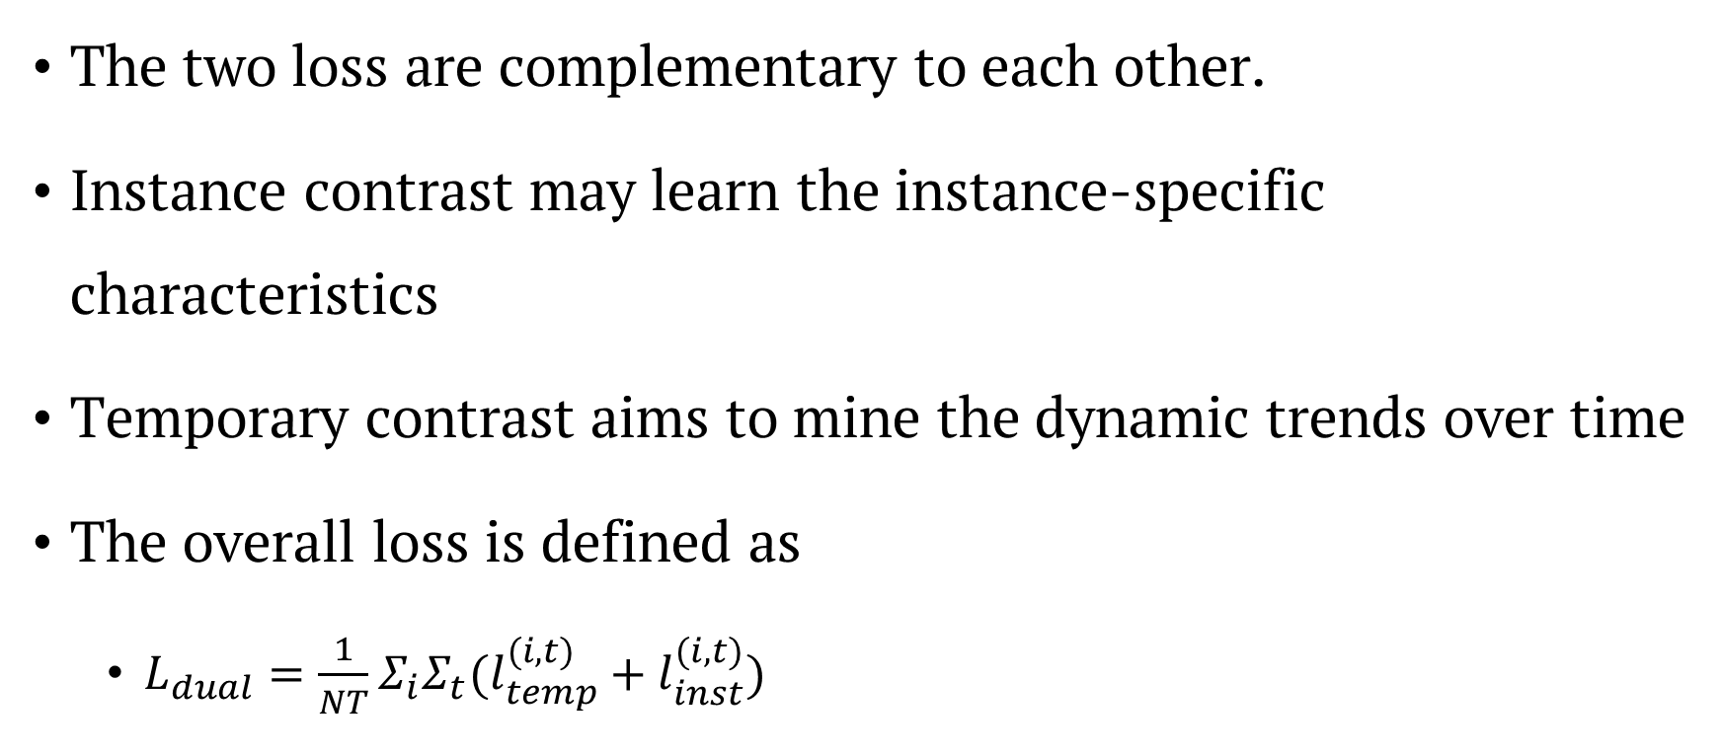
The overall loss
The two loss are complementary to each other.
Instance contrast may learn the instance-specific characteristics
Temporary contrast aims to mine the dynamic trends over time
The overall loss is defined as
$L_{dual}=\frac{1}{NT}Σ_{i}Σ_{t}(l_{temp}^{(i, t)}+l_{inst}^{(i,t)})$

Slide 33
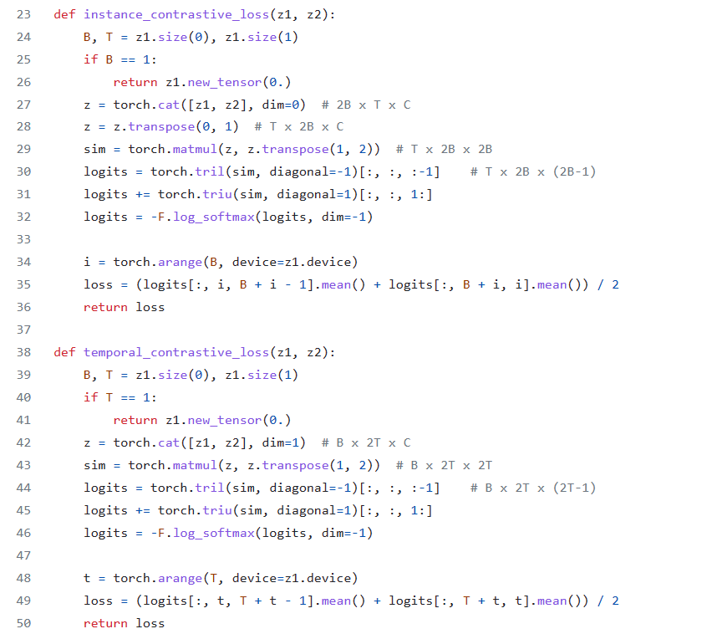

Slide 34
Timestamp Masking and Random cropping are only applied in the training phase

Slide 35
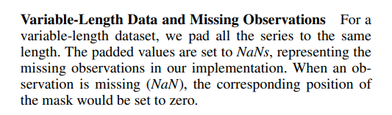
How to handle irregular time series data?

Slide 36
Time Series Anomaly Detection

Slide 37
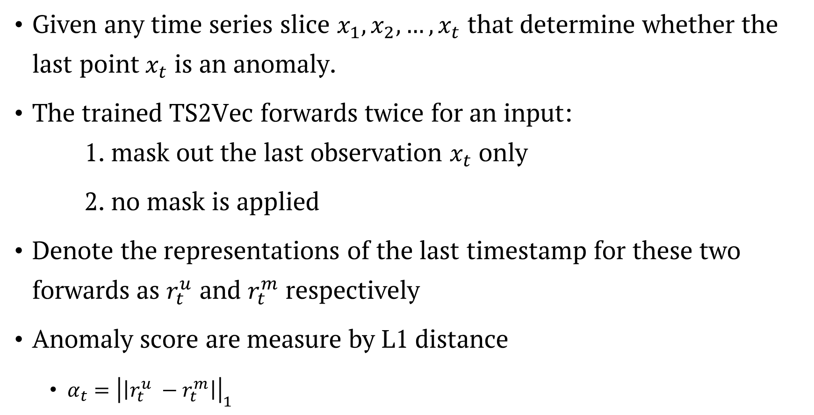
Time Series Anomaly Detection
Given any time series slice $x_{1}, x_{2},…,x_{t}$ that determine whether the last point$x_{t}$ is an anomaly.
The trained TS2Vec forwards twice for an input: 1. mask out the last observation $x_{t}$ only
2. no mask is applied
Denote the representations of the last timestamp for these two forwards as $r_{t}^{u}$ and $r_{t}^{m}$ respectively
Anomaly score are measure by L1 distance
$α_{t}={\left|\left|r_{t}^{u} −r_{t}^{m}\right|\right|}_{1}$

Slide 38
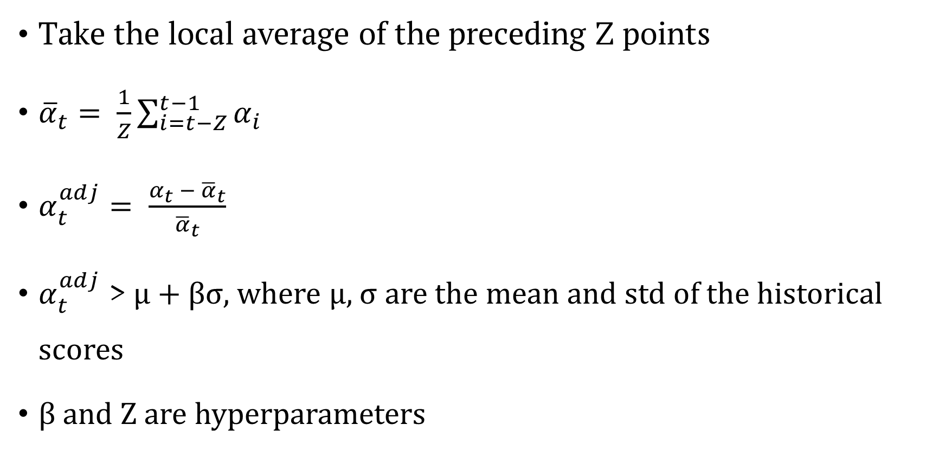
Time Series Anomaly Detection
Take the local average of the preceding Z points
${\overline{α}}_{t}= \frac{1}{Z}\sum_{i=t−Z}^{t−1}{α_{i}}$
$α_{t}^{adj}= \frac{α_{t} −{ \overline{α}}_{t}}{{\overline{α}}_{t}}$
$α_{t}^{adj}$ > μ + βσ, where μ, σ are the mean and std of the historical scores
β and Z are hyperparameters

Slide 39
Conclusion

Slide 40
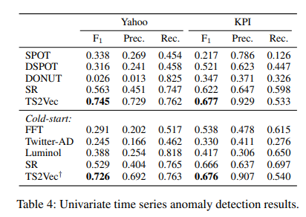
Experiment results
In anomaly detection tasks, despite claiming SOTA, the Recall is not the highest.

Slide 41
Conclusion
Training fast.
Steady performance.
Multiscale information in time-series.

Slide 42
Thanks for listening
Notes:
下週進度應是與之前學長討論，去把資料做成時間序列然後並且跑實驗試試

